Slide 1
Welcome! Before we get started…
Bandwidth: Please keep your video off and microphone muted in the main room to help with any bandwidth issues. We invite folx to turn on video and microphone in the breakout room.
Captions: Auto captioning is available. Click “Live Transcript” from the Zoom control bar, then select “Show Subtitle.”
Slides: We will share a link to our slides in the chat.
Attendance: Please ensure that your display name is accurate for those who would like the ED Institute Certificate.
To change your display name:
  Click “Participants” from the Zoom control bar.
  Next to your name, click “More >.”
  Select “Rename” and enter the name you wish to display.
Alternatively, if you do not want to display your name, send a private message to Matthew Dunleavy in the chat introducing yourself.

Slide 2
Developing and Managing Educational Development (ED) Skills
ED Institute 2022 Week 2
Véronique Brulé, McGill University
Samantha Chang, University of Toronto
Notes:
https://edinstitute2022.opened.ca/schedule/week-2/

Slide 3
Land Acknowledgement
Although we are gathered together virtually, we acknowledge the diverse lands from which we are participating, which have long served as sites of meeting and exchange amongst Indigenous peoples. We acknowledge and thank the diverse Indigenous peoples whose presence marks this space.
Please share with us in the chat, whose lands are you joining us from today? Is there a resource that you wish to share to help us learn more about the lands you are joining us from?

Slide 4
Access Check*
We understand access to be a shared responsibility between everyone in this space. We are striving to create an accessible space that reduces the need for you to disclose a disability or impairment to obtain an accommodation. In doing this together, we welcome disability, and the changes it brings, into our space.
*Adapted from the University of Toronto’s Centre for Teaching Support & Innovation, 2020.
Is there anything about the setup that we should address now?
Are there any other access needs that might affect your participation in the session that we could also address?
Please let us know in the chat or send a private message to the host or co-hosts.

Slide 5
Today’s Agenda
Identifying and Developing Educational ED Skills
Acquiring ED Skills: Learning from Our Colleagues
Organizing, Presenting, and Managing ED Skills

Slide 6
Identifying and Developing ED Skills
1

Slide 7
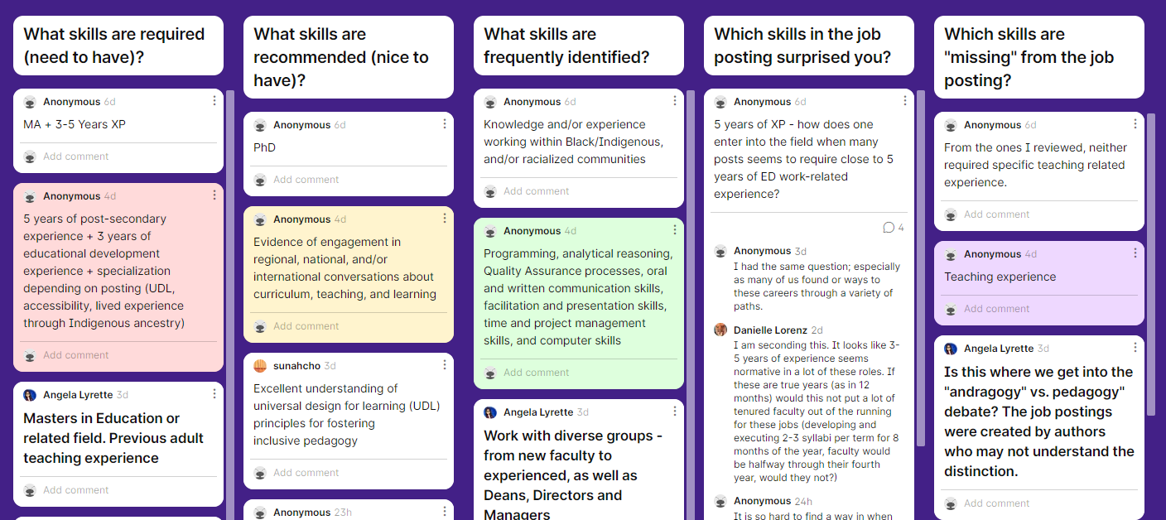
Padlet Recap: Ed Skills in Job Postings
Notes:
https://padlet.com/eddevinfo/ficl4j9k9170b7u7

Slide 8
Skills Development Matrix
 | Short term | Long term
Need to have
Nice to have
Download the Skills Development Matrix (DOCX or PDF) in the chat.

Slide 9
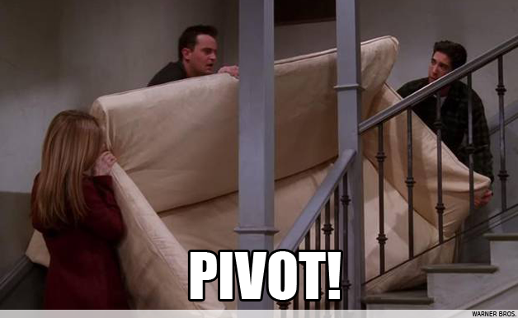
My Skills Development Matrix: Before
Before
 | Short term | Long term
Need to have | Lab pedagogy | Technology
Nice to have | Creativity | Change management
Notes:
Friends: Pivot! (Clip) https://youtu.be/8w3wmQAMoxQ

Slide 10
My Skills Development Matrix: After
Before
After
 | Short term | Long term
Need to have | Lab pedagogy | Technology
Nice to have | Creativity | Change management
 | Short term | Long term
Need to have | Adaptability Listening Technology | Change management
Nice to have | Creativity | Lab pedagogy

Slide 11
Acquiring ED Skills: Learning from Our Colleagues
2

Slide 12


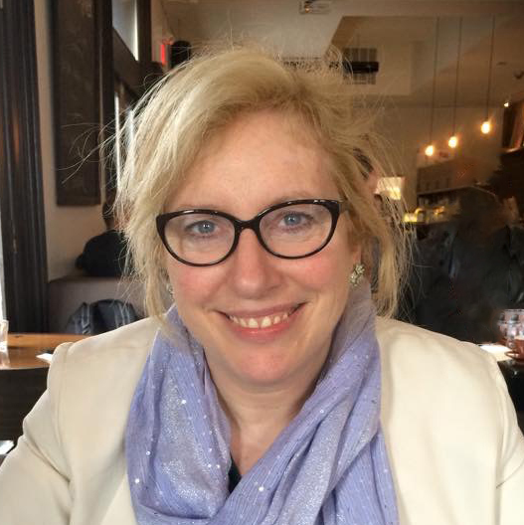
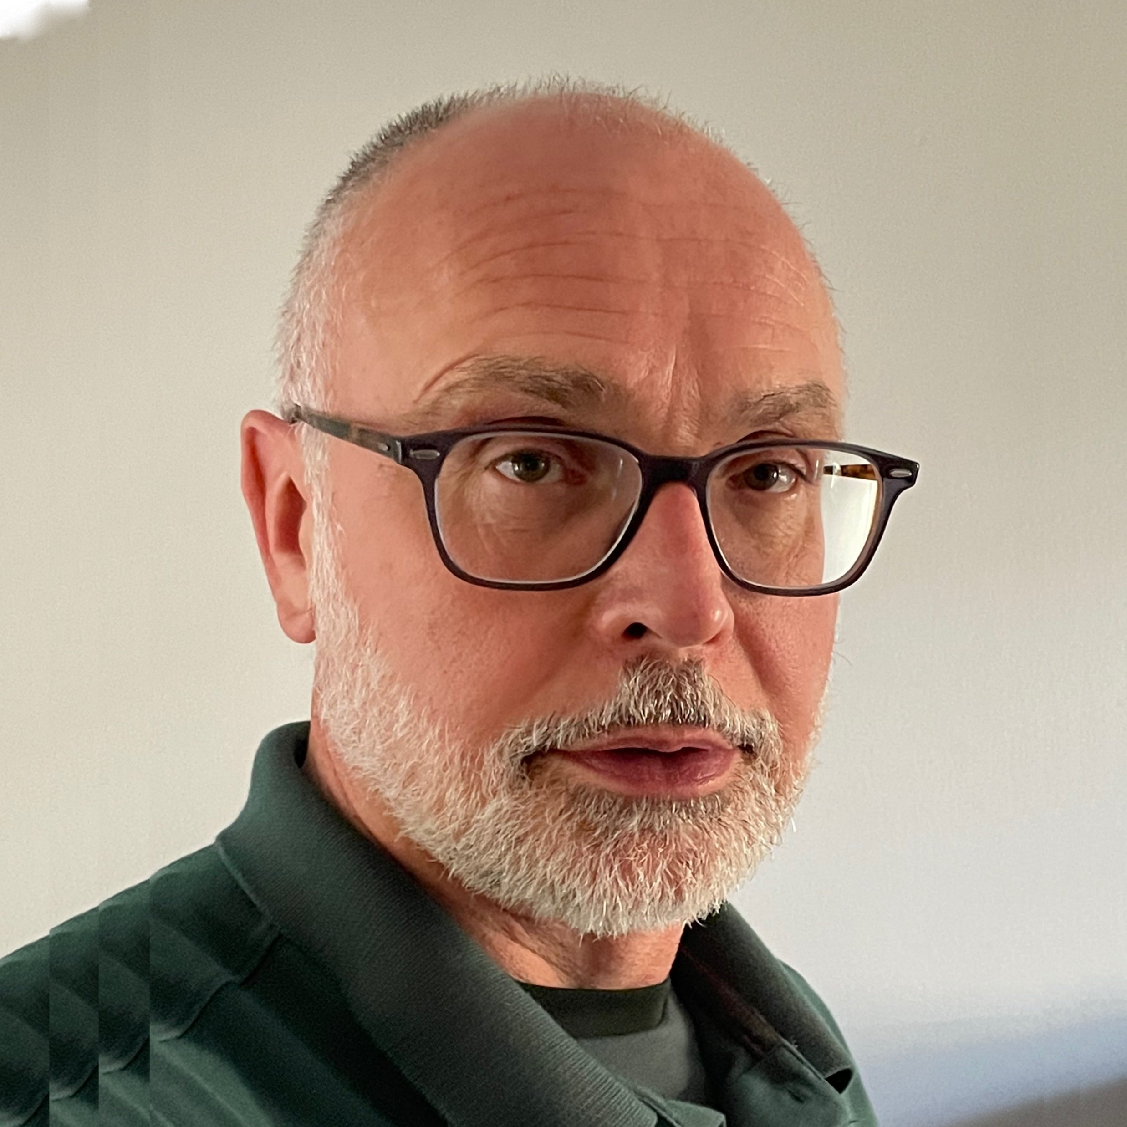
Our ED Panelists
Davis Vallesi
PhD Candidate
York University
Alex Kozelko
Supervisor, Educational Development
Red River College Polytechnic
Celia Popovic
Associate Professor
York University
Tim Loblaw
Director, Learning and Teaching Technology
Simon Fraser University

Slide 13
Panel Questions
How do you define ED skills and which skill(s) do you find the most valuable in your current role?
What skills have you changed, enhanced, or acquired due to the evolving contexts?
How do you track and present your skillset? How do you record what you’ve done, both results and process?

Slide 14
Organizing, Presenting, and Managing ED Skills
3

Slide 15
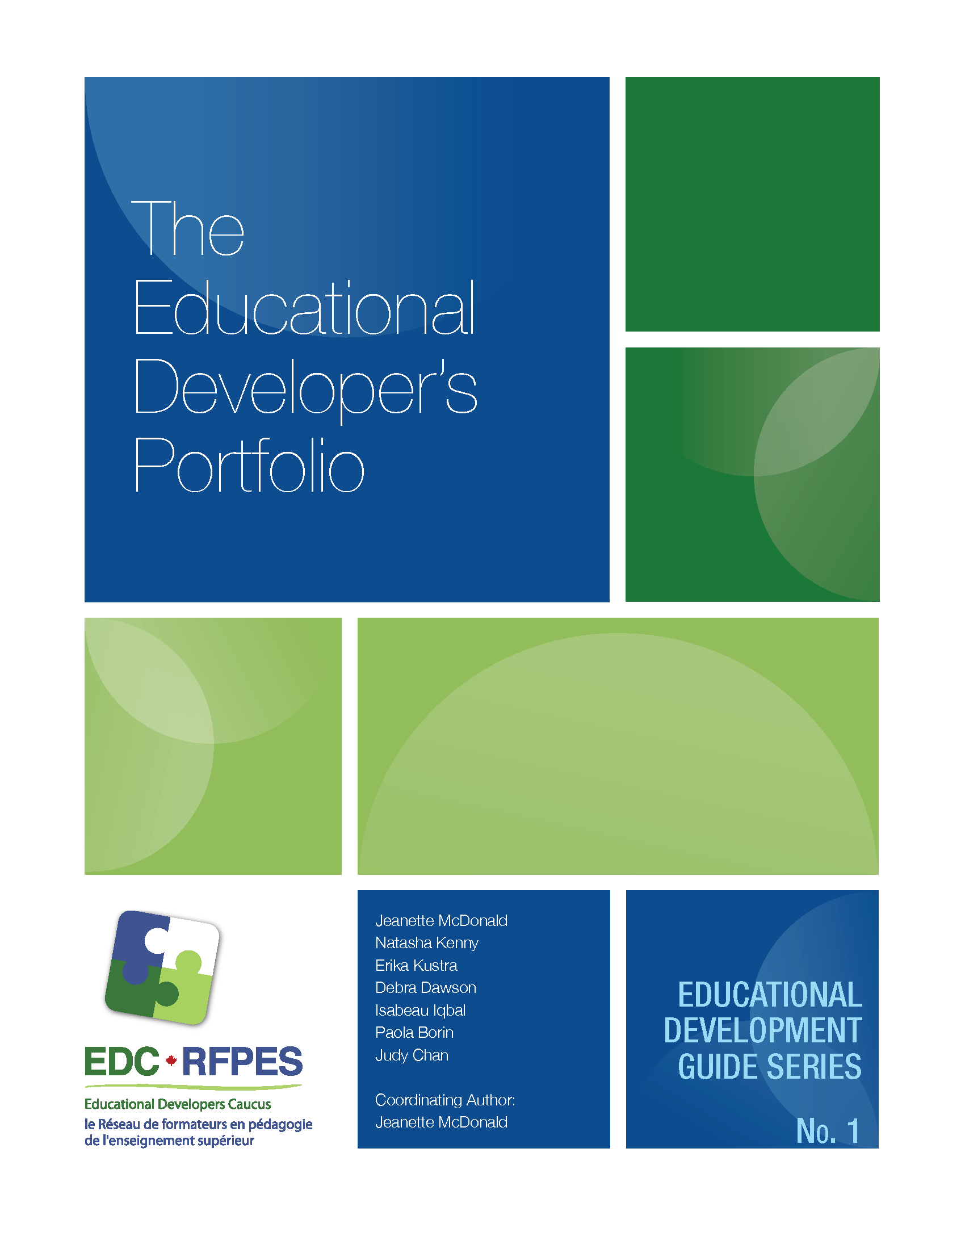
The ED Portfolio Appendices
Appendix A: Entry Level ED
Appendix B: Senior Level ED
Appendix C: Director Level ED
Items
Foundational characteristics
Skills and abilities developed in the learning process
Knowledge
Competencies
Notes:
Educational Development Guide Series: No. 1. The Educational Developer’s Portfolio PDF https://www.stlhe.ca/wp-content/uploads/2016/03/ED-Guide-No1_The-Educational-Developers-Portfolio_Final.pdf

Slide 16
Organizing ED Skills
Attributes, Qualities, and Values (Be)
Knowledge, Skills, and Abilities (Know/Do)
Commitment to improving self
Professional conduct
Management of work duties
Values
Teaching and learning
Educational development
Facilitation and change management
Planning and project management
Notes:
Educational Developer: Characteristics, Skills, Knowledge, and Abilities PDF https://ciel.viu.ca/sites/default/files/entry_level_competencies_for_ed_dev.pdf

Slide 17

Let’s Chat: Evidence of ED Skills
CVs and résumés
Publications and presentations
Portfolio of artifacts
Blog posts
Testimonials and feedback
LinkedIn skills endorsements
Emails (smile file)
What else? What’s missing?
Notes:
https://beth-myers.com/portfolio

Slide 18
Skills Management Matrix
Job Diversification Diversifying the Existing Skillset | Career Change Building a Brand New Skillset
Job Excellence Perfecting the Existing Skillset | Job Enhancement Extending the Existing Skillset
Chukhlomin, V. (2018). How to Get Skilled: A Brief Introduction to Individual Skills Management. Upward Mobility Books.

Slide 19
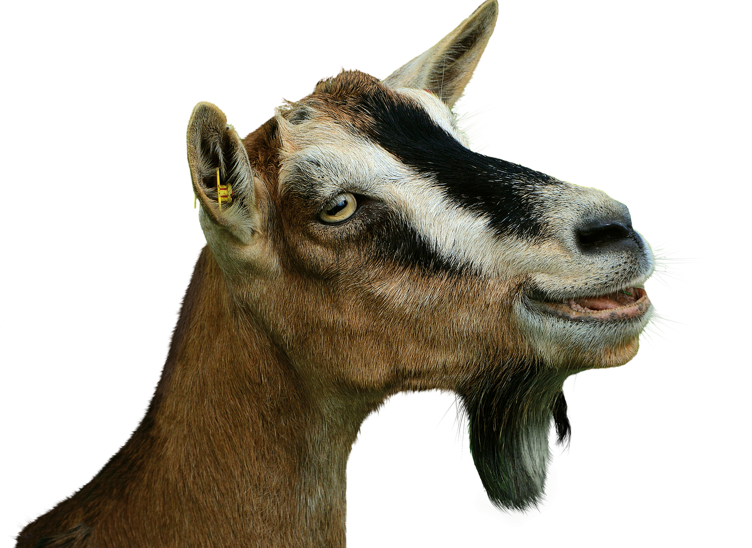
Go forth and be a GOAT* !
*Greatest Of All Time

Slide 20
Further Reading
Bortolin, K. (2017). A Day in the Life of an Educational Developer. Learning Design for Deep Learning.
Chang, S., D’Amico, C., & Kasprzak, M. (2022). Finding Your Voice in Educational Development. University Affairs.
Knaack, L. (2017). Educational Developer: Characteristics, Skills, Knowledge, and Abilities. Vancouver Island University.
Knaack, L. (2017). Senior Educational Developer/Learning Consultant: Characteristics, Skills, Knowledge, and Abilities. Vancouver Island University.
McDonald, J., Kenny, N., Kustra, E., Dawson, D., Iqbal, I., Borin, P., & Chan, J. (2016). Educational Development Guide Series: No. 1. The Educational Developer’s Portfolio. Ottawa, Canada: Educational Developers Caucus.
POD Network. Getting Started in an Educational Development Career.
Popovic, C., & Smart, F. (2020). Educational Developers Thinking Allowed. York University.

Slide 21
Thank You!
Wednesday, May 25, 1–2:30 pm EDT
Establishing, Expanding, and Strengthening Your Professional Network
Wednesday, June 1, 1–2:30 pm EDT
Equity, Diversity, Inclusion and Educational Development
edinstitute2022.opened.ca

