Slide 1
Welcome! Before we get started…
Bandwidth: Please keep your video off and microphone muted in the main room to help with any bandwidth issues. We invite folx to turn on video and microphone in the breakout room.
Captions: Auto captioning is available. Click “Live Transcript” from the Zoom control bar, then select “Show Subtitle.”
Slides: We will share a link to our slides in the chat.
Attendance: Please ensure that your display name is accurate for those who would like the ED Institute Certificate.
To change your display name:
  Click “Participants” from the Zoom control bar.
  Next to your name, click “More >.”
  Select “Rename” and enter the name you wish to display.
Alternatively, if you do not want to display your name, send a private message to Matthew Dunleavy in the chat introducing yourself.

Slide 2
Establishing, Expanding, and Strengthening Your Professional Network
ED Institute 2022 Week 3
Brian Nairn, St. Clair College
Samantha Chang, University of Toronto

Slide 3


Land Acknowledgement
St. Clair College would like to recognize and acknowledge that it sits on the three fires confederacy’s traditional territory of the Ojibwe, Odawa, and Potawatomi nations. We would also like to acknowledge the many other tribes and indigenous nations that call this beautiful land home. We give thanks to the land and surrounding Water for sustaining us.
Left: St. Clair College
Right: Cherry blossoms blooming
outside of Robarts Library at the
University of Toronto
We wish to acknowledge this land on which the University of Toronto operates. For thousands of years it has been the traditional land of the Huron-Wendat, the Seneca, and the Mississaugas of the Credit. Today, this meeting place is still the home to many Indigenous people from across Turtle Island and we are grateful to have the opportunity to work on this land.

Slide 4
Access Check*
We understand access to be a shared responsibility between everyone in this space. We are striving to create an accessible space that reduces the need for you to disclose a disability or impairment to obtain an accommodation. In doing this together, we welcome disability, and the changes it brings, into our space.
*Adapted from the University of Toronto’s Centre for Teaching Support & Innovation, 2020.
Is there anything about the setup that we should address now?
Are there any other access needs that might affect your participation in the session that we could also address?
Please let us know in the chat or send a private message to the host or co-hosts.

Slide 5
Today’s Agenda
Identifying Our Professional Network Using the Educational Developers Development Map
Learning From Our Colleagues: Reflections About Pathways and Networks
Expanding Our Professional Network: ED Speed Networking

Slide 6
Identifying Our Professional Network Using the Educational Developers Development Map
1

Slide 7
ED Professional Development Map (EDPDM)
Mentorship
Sponsors, Observers, Brokers, Guidance/Direction
Sharing Expertise
Collaborators, Learning Communities and Professional Organizations, Brainstorming/Feedback, Writing
Work/Life Balance
Safe Space, Community, Inspiration/Motivation, Self-Care
Me and My Profession
Professional Learning
Role Models, Leadership, Learning Communities and Professional Organizations, Online/Print Resources

Slide 8
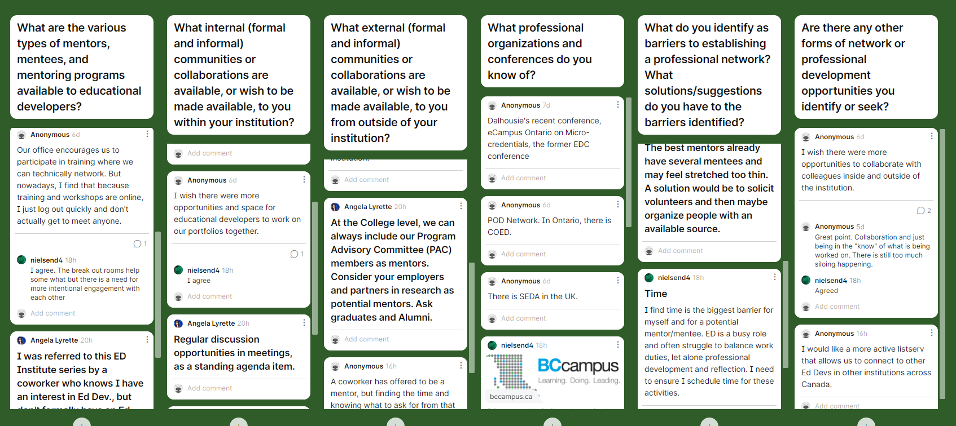
Padlet Recap: EDPDM Brainstorm

Slide 9
Learning From Our Colleagues: Reflections About Pathways and Networks
2

Slide 10
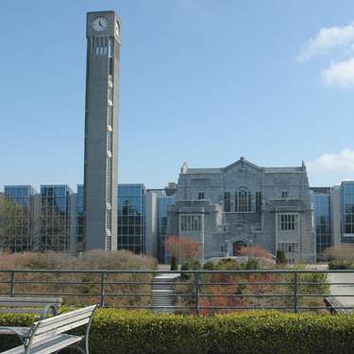
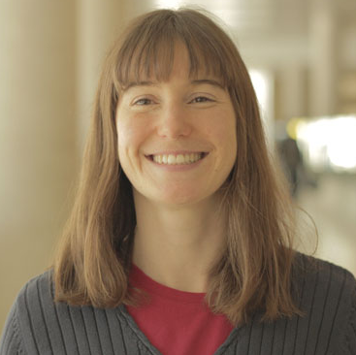
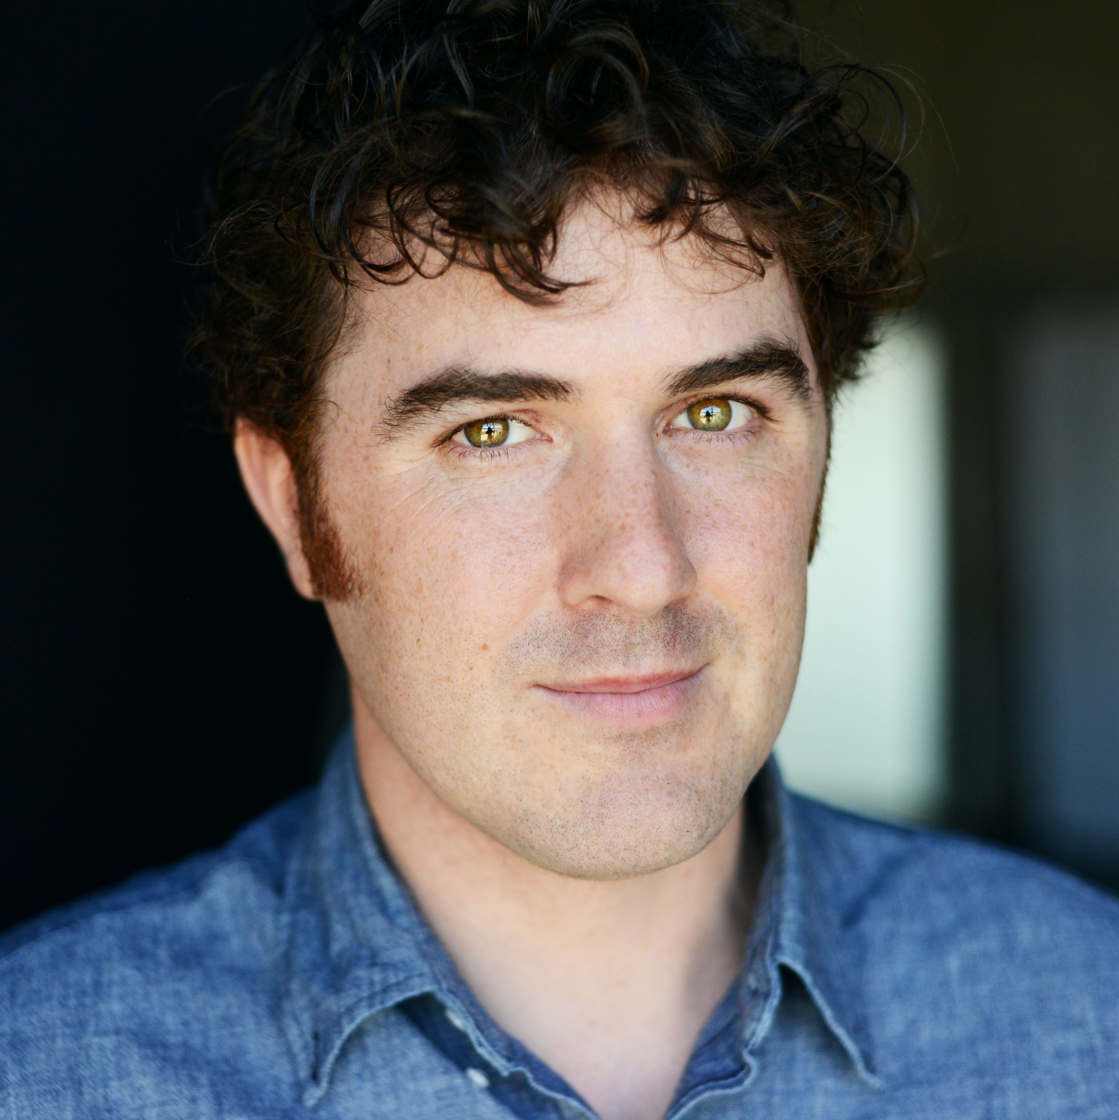
Our ED Panelists
Shaya Golparian
Educational Developer
University of British Columbia
Natasha May
Educational Developer
York University
Neil Silcox
Faculty Excellence Lead
Maple League of Universities

Slide 11
Panel Questions
What was your pathway into educational development?
How did your pathway help you build and define your professional network?
How has your professional network helped you grow as an educational developer?

Slide 12
Expanding Our Professional Network: ED Speed Networking
3

Slide 13
Breakout: ED Speed Networking
3 speed networking rounds (7 minutes each)
3–5 participants per breakout room
Talking Points
Introduce yourself
Highlight one takeaway from the panel
Identify one network you are seeking or offer one support you are able to provide
Share contact information!

Slide 14

Speed Networking Recap (Annotation Activity)

Slide 15
Further Reading
Bahlmann, G. (n.d.). Networking for People Who Absolutely Hate Networking. tribemineblog.com.
Greenwald, C. S. (2020). No More Excuses! Build a Contact List to Fuel Your Career. American Bar Association.
Guido, A. (2019). Why Being Kind Is Your Best Networking Strategy and How To Do It. Career Protocol.
Popovic, C. (n.d.). Connections. Educational Developers Thinking Allowed. Includes subpages about professional organizations, conferences, journals and other publications, listservs, social media, internal connections, exchanges and visits, mentoring and consultancy.
Zack, D. (2019). A Networking Survival Kit for People Who Hate Networking. Berrett-Koehler Publishers.

Slide 16
Thank You!
Wednesday, June 1, 1–2:30 pm EDT
Equity, Diversity, Inclusion and Educational Development
edinstitute2022.opened.ca

